Slide 1
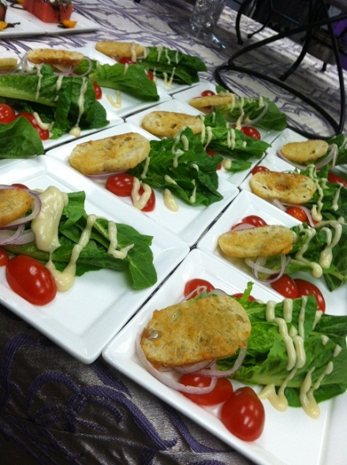
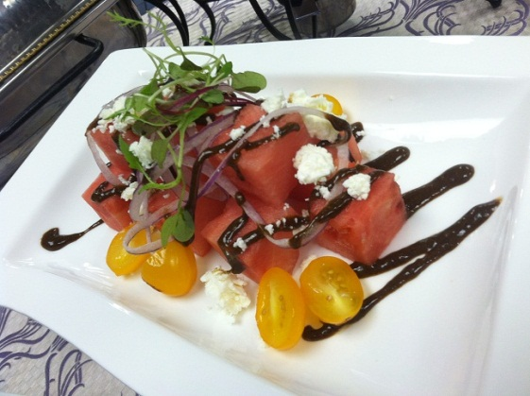
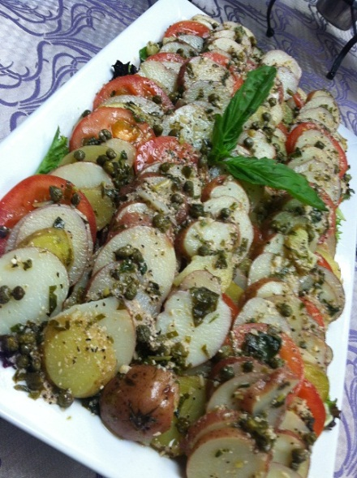
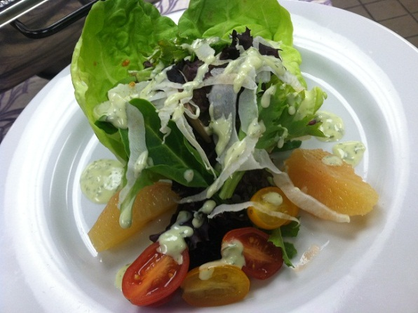
Adam Gooch
Executive Chef
Purple Onion Catering Co.
SPRING AHEAD

Slide 2

Spring Ahead Webinar
Fresh flavors and crisp textures
Cool technics to produce items
Infusion of new salt flavors
Pre portioning items to help in the field as well as food cost %
Flavorful finish! Make that vinaigrette pop with flavor and used as a visual accent

Slide 3

Watermelon and Feta Salad
Yellow Grape Tomatoes, Purple Onion Ribbons
And finished with a Minted Balsamic Glaze

Slide 4
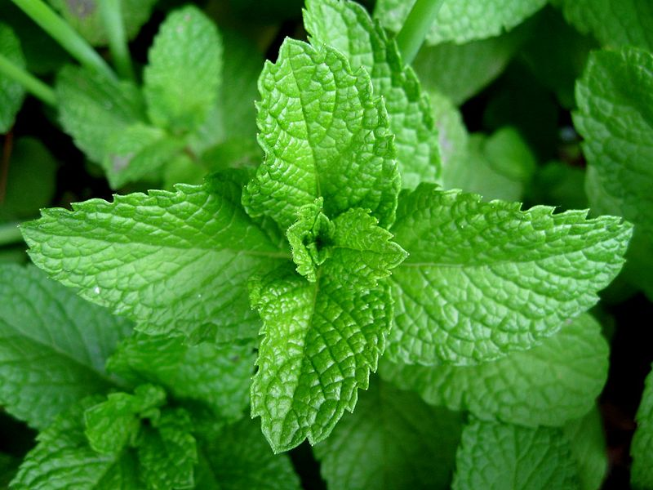
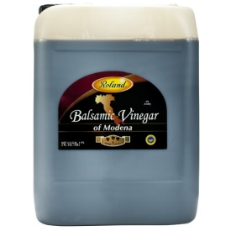
Minted Balsamic Glaze
Yield 2 Qts
2 cup Mint, Fresh, Chopped
4 cup Balsamic Vinegar
2 cup Sugar
1 ½ cup Oil Blended
2 Tsp Salt Kosher
3 Tsp Xanthan Gum
Place all ingredients into 1 gallon container
Using a hand blender puree until smooth
Place in squeeze bottles
Label and Place in Cooler

Slide 5
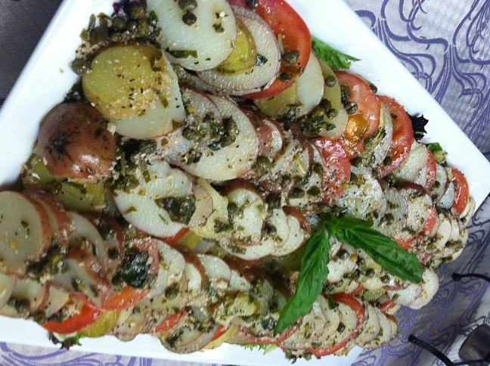
Tuscan Potato and Roma Tomato Salad with Basil Caper Dressing

Slide 6
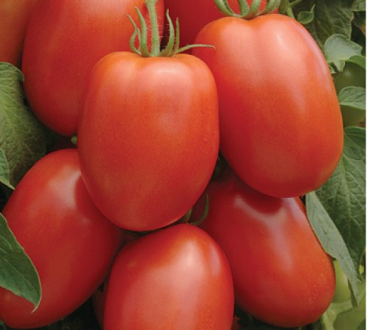
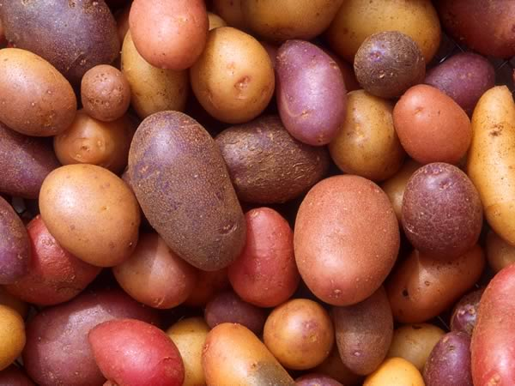
Yield 16 – 5 oz servings
3 Lbs. Red Skin Potatoes, Sliced ¼ inch
1 Lbs. Yukon Potatoes, Sliced ¼ inch
1 Lbs. Roma Tomatoes, Sliced ¼ inch
1 ½ cup Extra Virgin Oil
½ cup Red Wine Vinegar
¼ cup Lemon Juice, Fresh
4 Tbsp Capers
1 Tbsp Garlic, Minced
½ cup Basil, Chiffonade
1 Tbsp Black Pepper
1 cup Grated Parmesan
Place potatoes in salted water and bring to boil.
Cook until tender, DO NOT OVER COOK.
Meantime place all remaining ingredients( except Tomatoes) in bowl and mix
Once potatoes are done remove and drain.
Place in hotel pan and cover with dressing. Place in cooler to chill.
Platter on any vessel, Serve room temp for

Slide 7

Boston Bibb and Mixed Greens
Shaved Fennel, Citrus Sections, Yellow and Red Grape Tomatoes

Slide 8
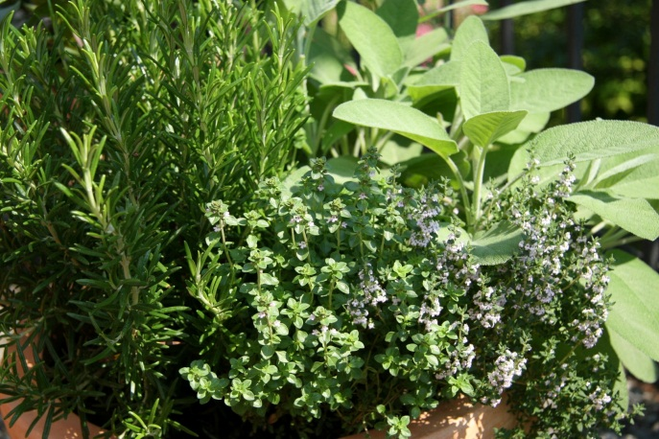
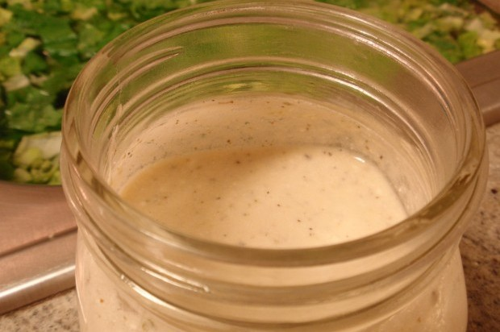
Creamy Herb Vinaigrette
1 cup Rice Wine Vinegar
1 cup Sour Cream
1 cup Mayonnaise
2 cup Oil Blended
2 Tbsp Thyme, Chopped
½ cup Basil, Chopped
½ cup Parsely, Chopped
½ cup Dill, Chopped
1 tsp Garlic, Minced
Place all ingredients in 1 gallon container
Using Hand Blender puree until Smooth
Label and Place in Squeeze bottles

Slide 9
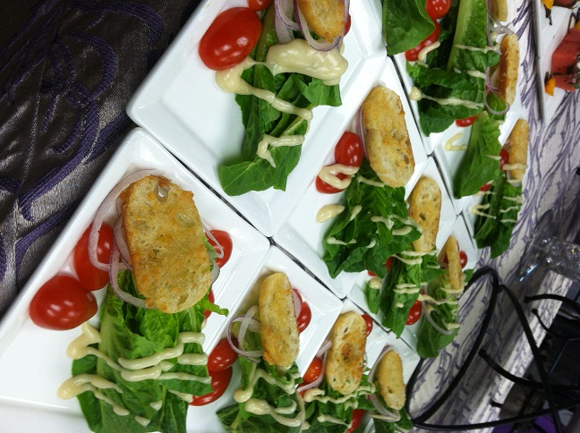
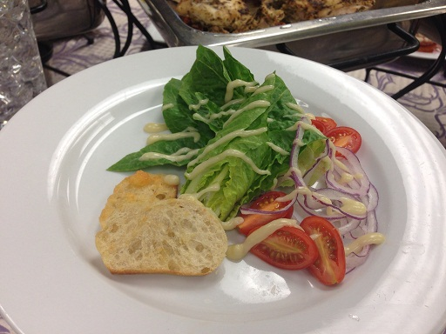
Modern Caesar Salad
Purple Onion Ribbons, Grape Tomatoes and Parmesan Crips

Slide 10
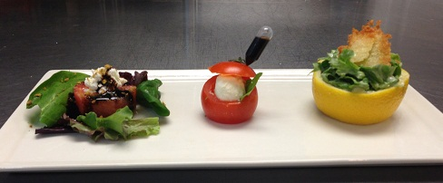
Trio Salad Plate
Watermelon and Feta / Caprese Tomato / Lemon Caesar Cup

Slide 11
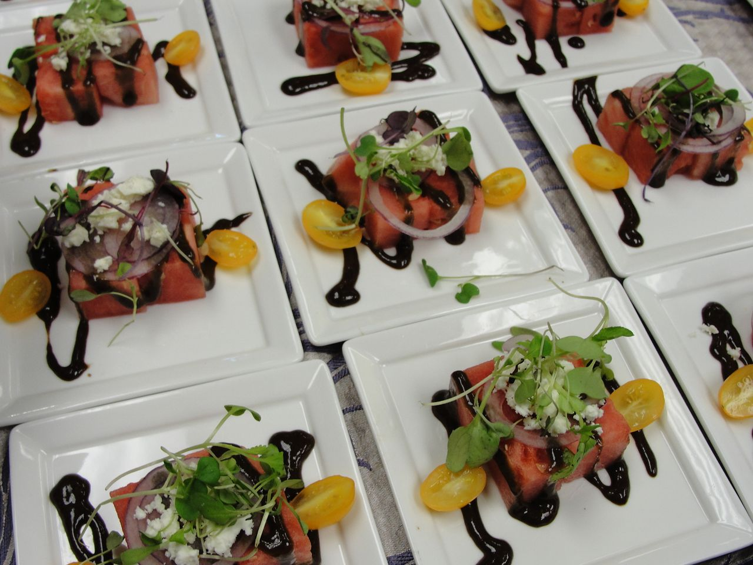
Small Plate Salads
Use small plates to create different presentation

Slide 12
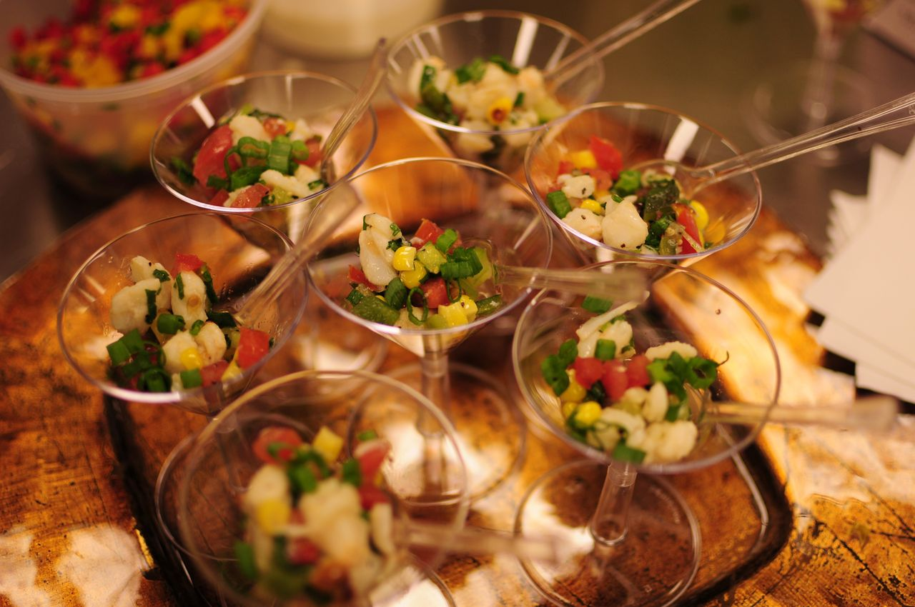
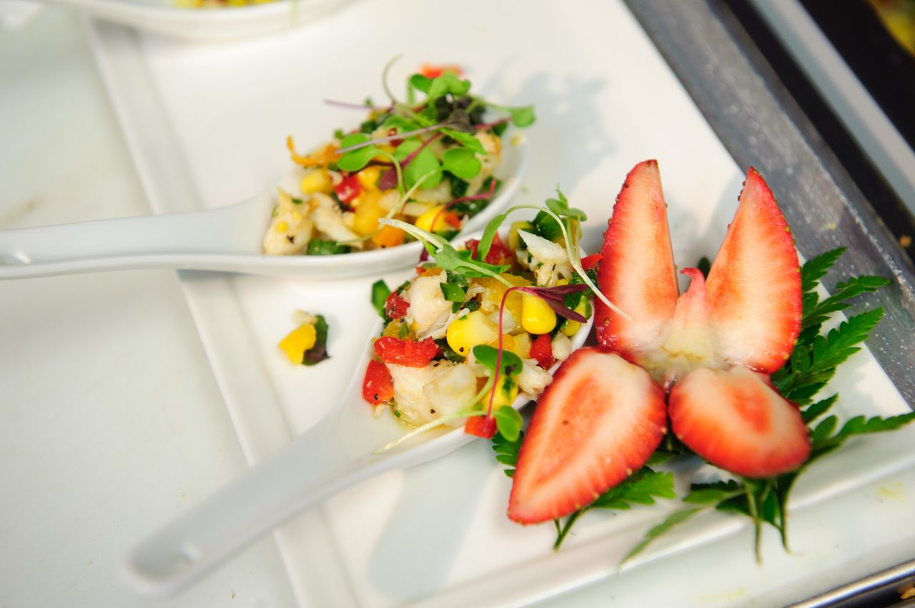
Different Vessels
Go Out of The Box, Have Fun

Slide 13
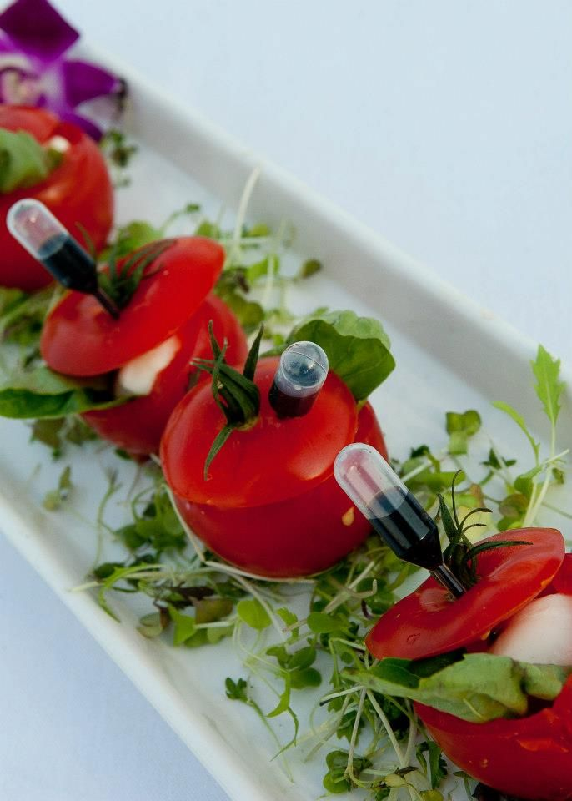
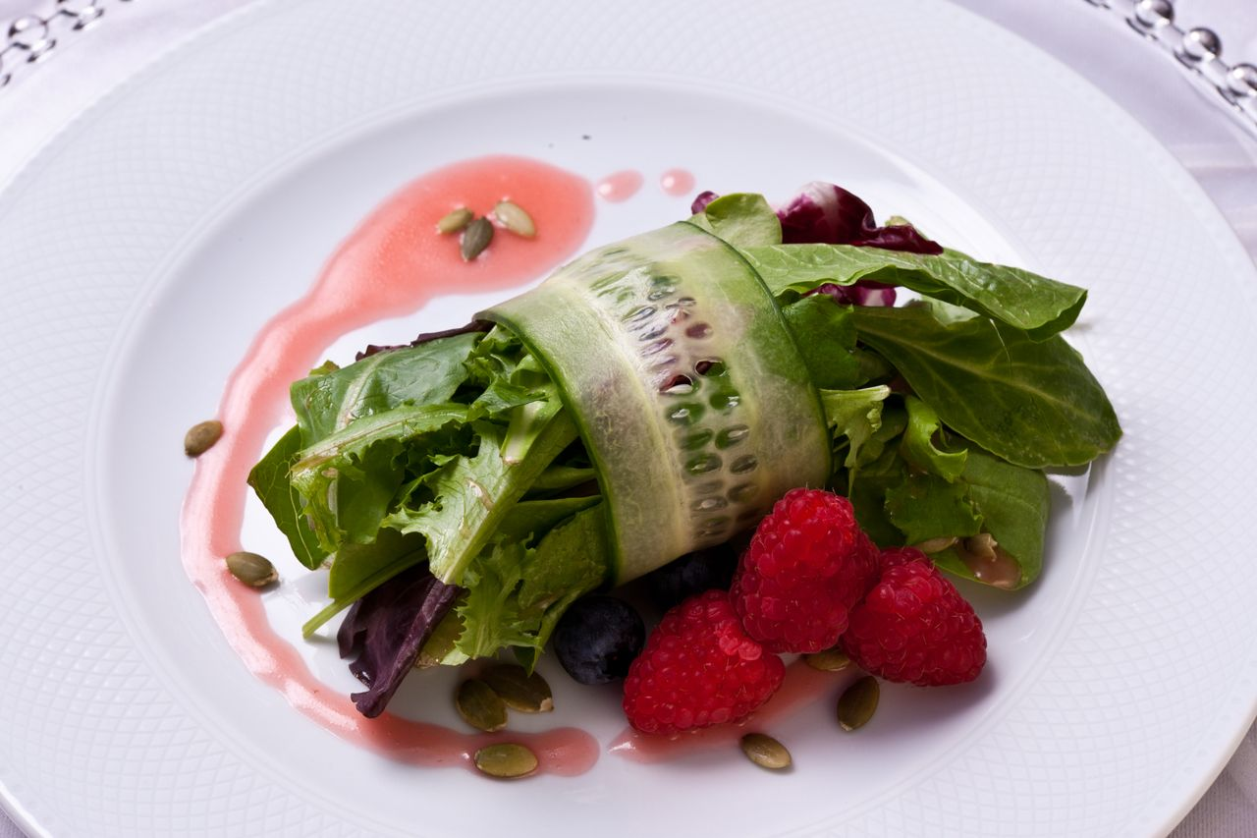
Spin on Traditional Items
Create different presentations using ingredients already in the dish

Slide 14
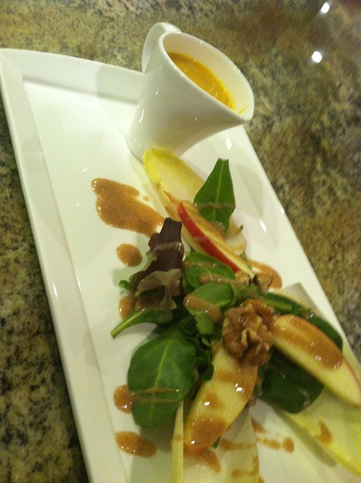
Soup and Salad
Bring the guests a different sample on a all time classic

Slide 15
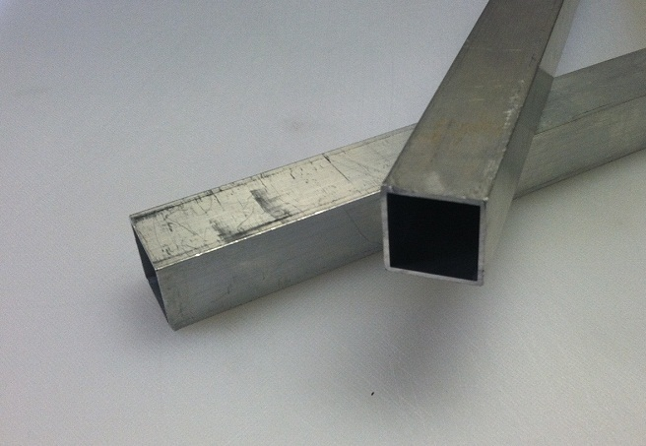
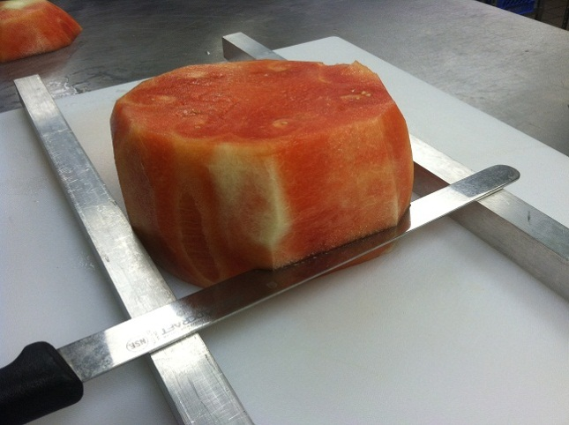
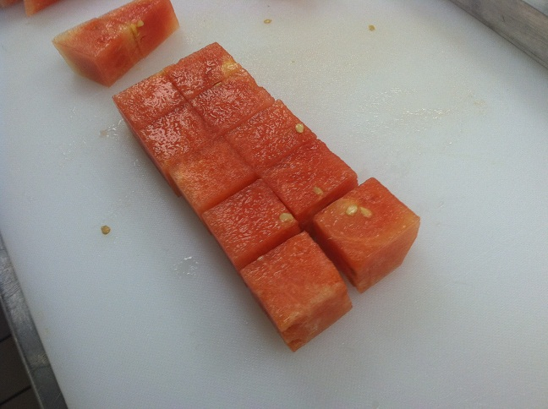
Production Tricks
How can I produce in volume and Save Time
Alum bars from hardware store help cut perfect cubes and speeds production
Them make in different sizes so you can produce any size squares

Slide 16
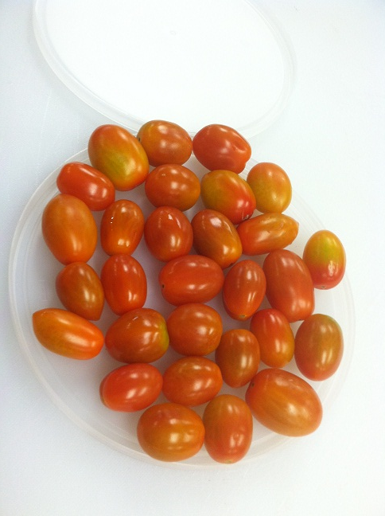
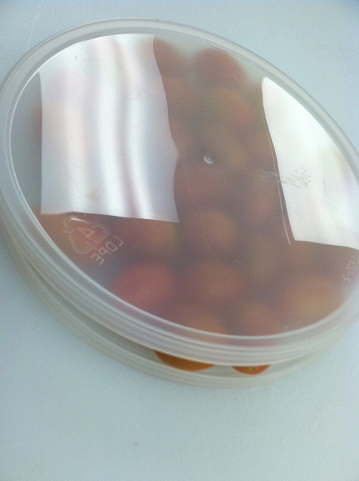
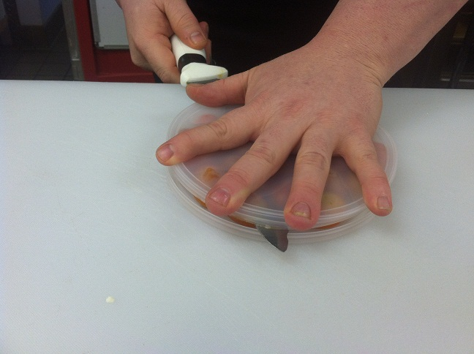
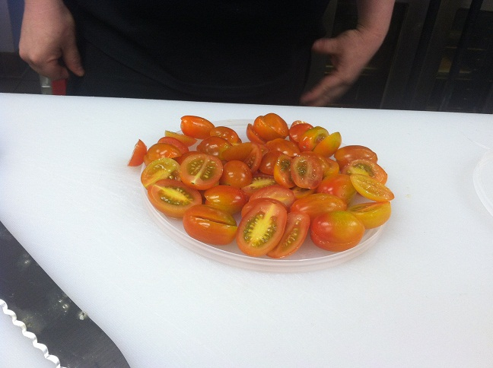
Production Tricks
How can I produce in volume and Save Time

Slide 17
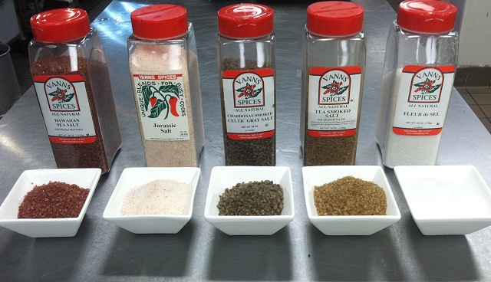
Hot Trends 2013
Spice up your Salads with great sprinkle of flavored salts

Slide 18
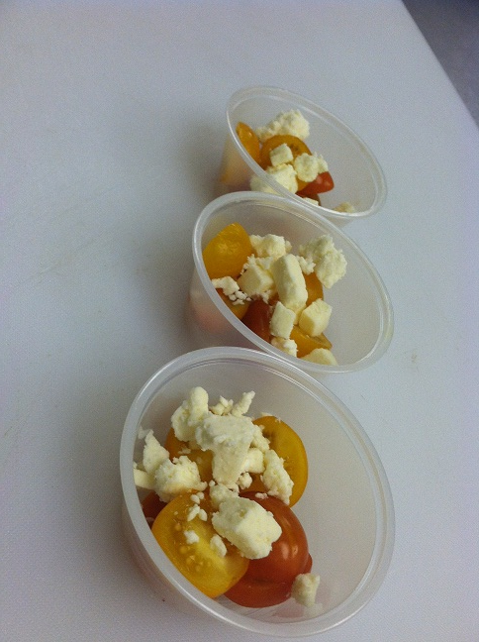
Production Tricks
Save Time and $ in the Field
We pre-portion all garnishes for salads at the shop. This controls the amount
going on each salad, easy for field chefs or servers and makes sure you have the right amount. We do this for almost everything we can.

Slide 19
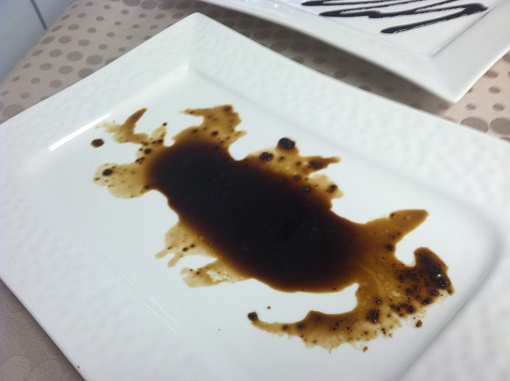
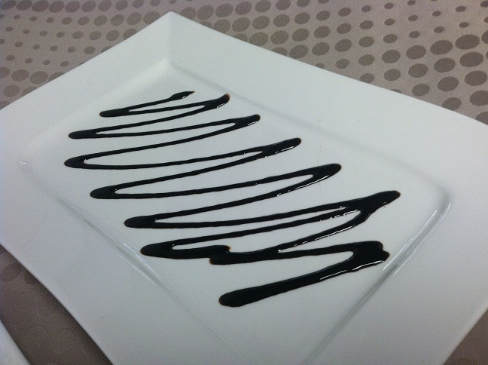
What looks Better to You?
This is the same recipe! On left traditional style Balsamic Vinaigrette and on right same Balsamic Vinaigrette pureed with xanthan gum added.
Of course they both have there places but on plated salad there's a big difference. Play around with your recipe and see what you can do.

Slide 20

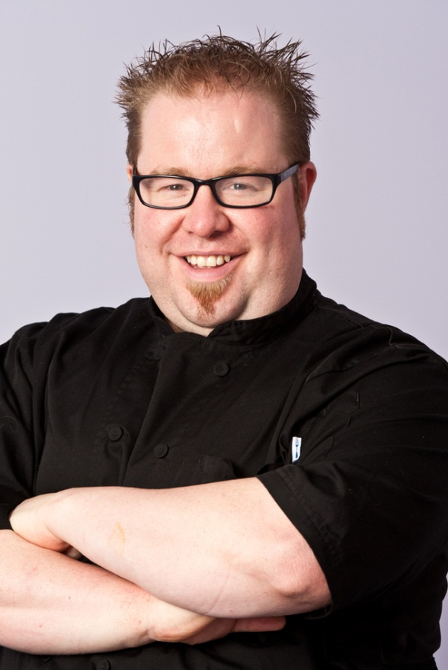
Adam Gooch
Executive Chef
adam@purpleonioncatering.com
www.purpleonioncatering.com
724.420.7810
www.facebook.com/chefadamgooch

