Slide 1
NOT
SLEAZY…
JUST
EASY
Enticing & Tempting Desserts…
that leaves your clients beckoning
for more

Slide 2
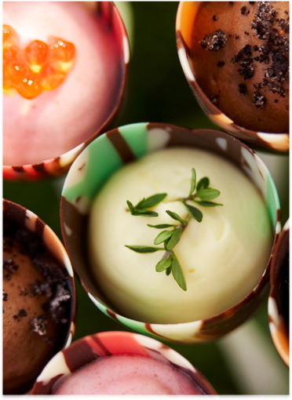
CATERING FRIENDLY RECIPES TO ADD TO YOUR MENU
PRESENTATION TRICKS AND TECHNIQUES FOR PLATED &
PLATTERED DESSERTS
MAKE AHEAD IDEAS FOR DESSERTS YOU CAN FINISH ON SITE
A GREAT FINISH:
SAUCE PAINTING
FAST GARNISHES
CHOCOLATE GANACHES
Not Sleazy…Just Easy
Enticing tempting desserts that leaves your clients
beckoning for more.
March 3, 2014
Presented by Donna Ford, CPCE
www.sweetmemoriesbakery.com
www.cravenc.com

Slide 3
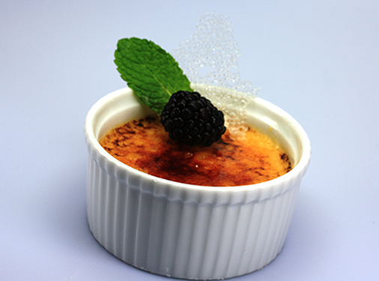
Crème Brulee
Nothing compares to Crème Brulee
It takes the simplest ingredients:
fresh cream, sugar, eggs, vanilla bean
Deliciously decadent
Can range from classic to extravagant
Not Sleazy…Just Easy
Enticing tempting desserts that leaves your clients
beckoning for more.
March 3, 2014
Presented by Donna Ford, CPCE
www.sweetmemoriesbakery.com
www.cravenc.com

Slide 4
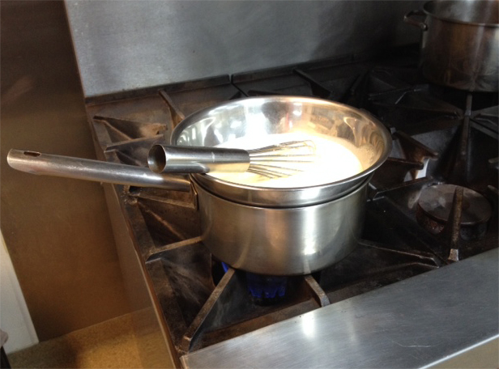
Crème Brulee
Cooking Method
There are 2 basic ways to prepare crème brulee
First Method:
Cream is blended with other ingredients and baked in a water bath until set.
Baking produces a firm texture
Second Method:
Stirring the cream on the stove
If you are infusing flavors or planning to serve in an edible bowl or shell
Produces a custard with a creamy texture
Not Sleazy…Just Easy
Enticing tempting desserts that leaves your clients
beckoning for more.
March 3, 2014
Presented by Donna Ford, CPCE
www.sweetmemoriesbakery.com
www.cravenc.com

Slide 5
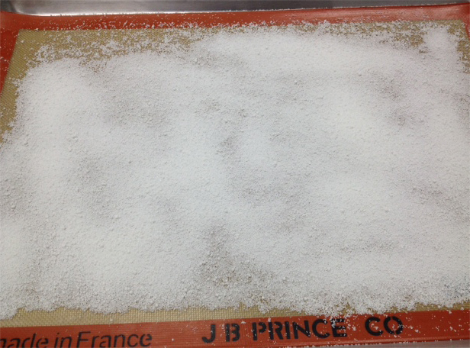
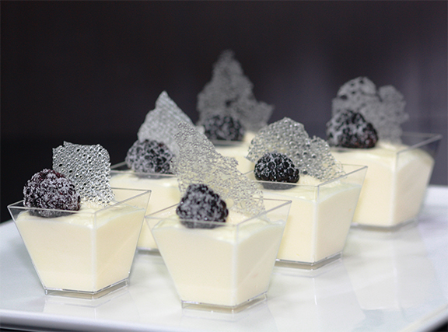
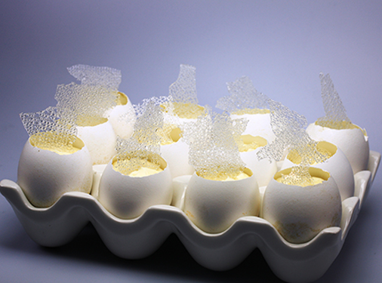
Crème Brulee
Finishing
Traditional:
Topped with sugar
Caramelized with a torch
Sugar glass:
Adds crunch
Decoration
Heat sensitive containers
Not Sleazy…Just Easy
Enticing tempting desserts that leaves your clients
beckoning for more.
March 3, 2014
Presented by Donna Ford, CPCE
www.sweetmemoriesbakery.com
www.cravenc.com

Slide 6
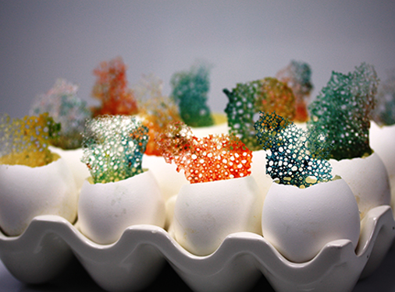
Crème Brulee
Finishing
Color
Flavoring
Fruit
Chocolate
Not Sleazy…Just Easy
Enticing tempting desserts that leaves your clients
beckoning for more.
March 3, 2014
Presented by Donna Ford, CPCE
www.sweetmemoriesbakery.com
www.cravenc.com

Slide 7
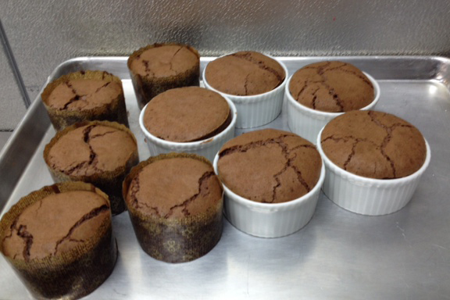
Chocolate Souffles
Non Traditional
Traditionally a nightmare
Can be prepared ahead
Can be frozen
Can be baked ahead or on site
Not Sleazy…Just Easy
Enticing tempting desserts that leaves your clients
beckoning for more.
March 3, 2014
Presented by Donna Ford, CPCE
www.sweetmemoriesbakery.com
www.cravenc.com

Slide 8
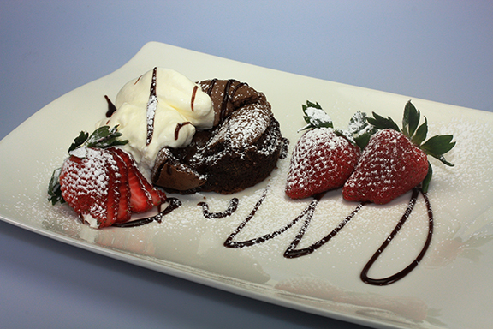
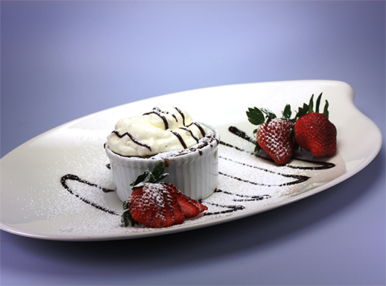
Chocolate Souffles
Finishing
Whip Cream
Ice Cream
Fruit
Sauces
Sugar
Chocolate
Not Sleazy…Just Easy
Enticing tempting desserts that leaves your clients beckoning for more.
March 3, 2014
Presented by Donna Ford, CPCE
www.sweetmemoriesbakery.com
www.cravenc.com

Slide 9
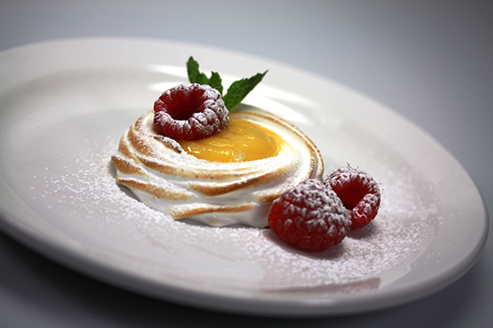
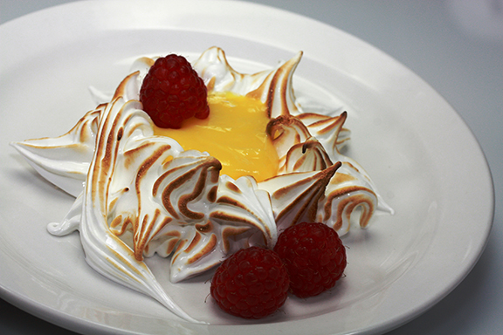
Meringue
Versatile
Stable
Yummy
Not Sleazy…Just Easy
Enticing tempting desserts that leaves your clients
beckoning for more.
March 3, 2014
Presented by Donna Ford, CPCE
www.sweetmemoriesbakery.com
www.cravenc.com

Slide 10
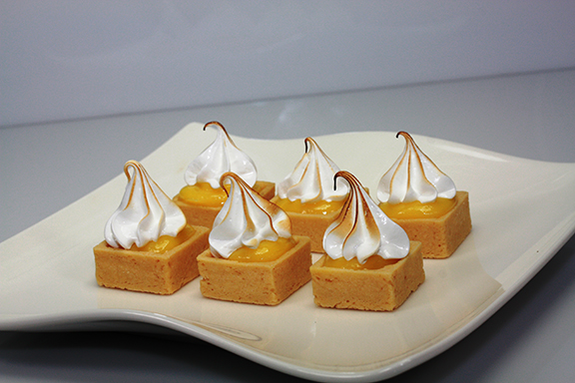
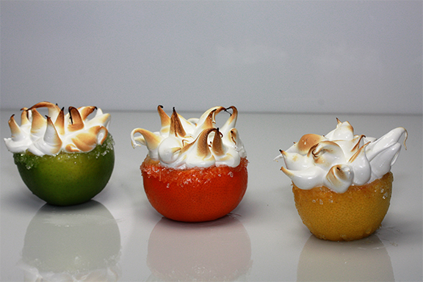
Meringue
Passed
Plated
Table Presentation
Not Sleazy…Just Easy
Enticing tempting desserts that leaves your clients
beckoning for more.
March 3, 2014
Presented by Donna Ford, CPCE
www.sweetmemoriesbakery.com
www.cravenc.com

Slide 11
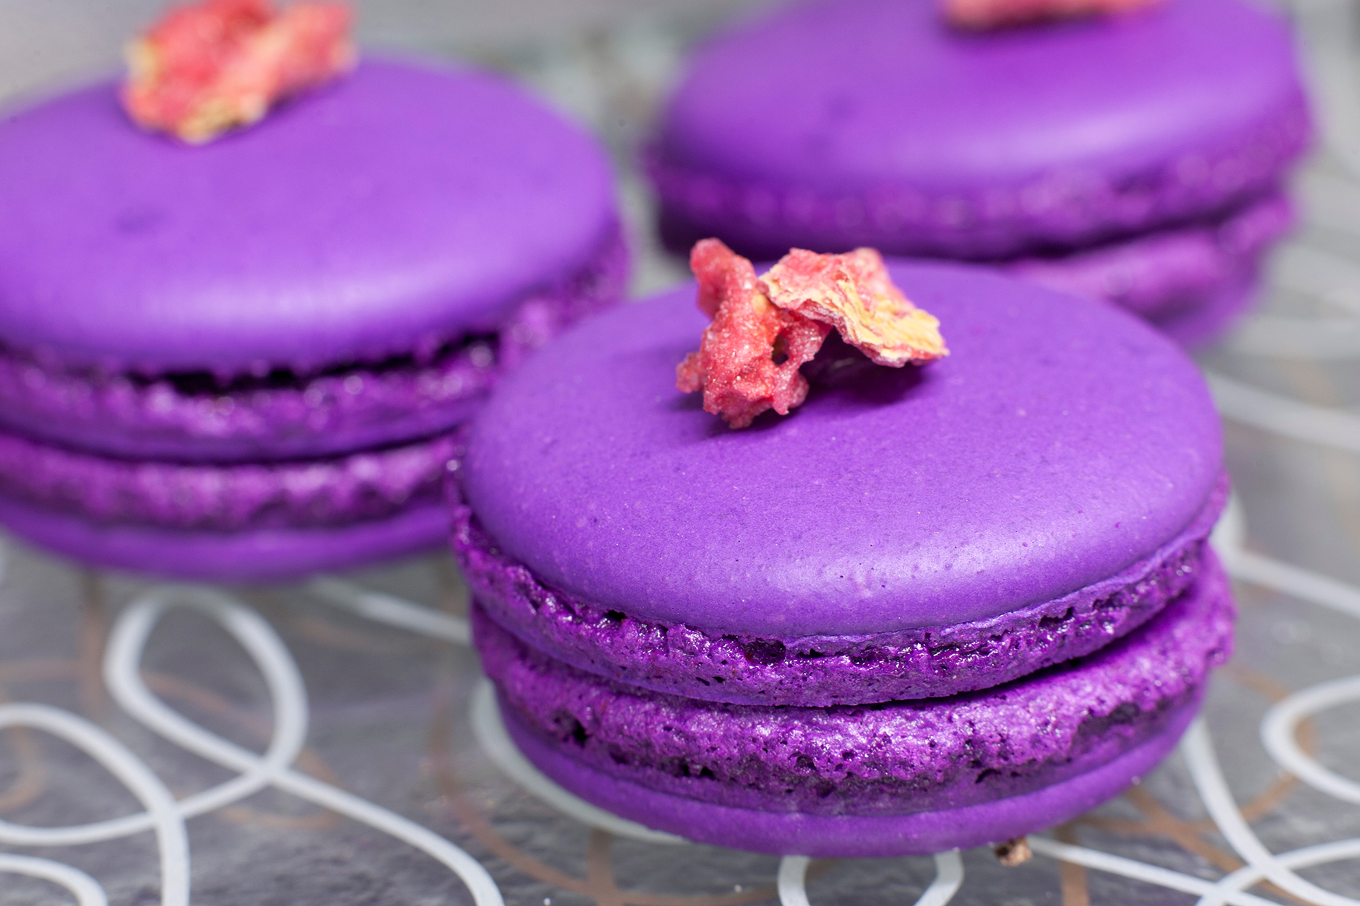
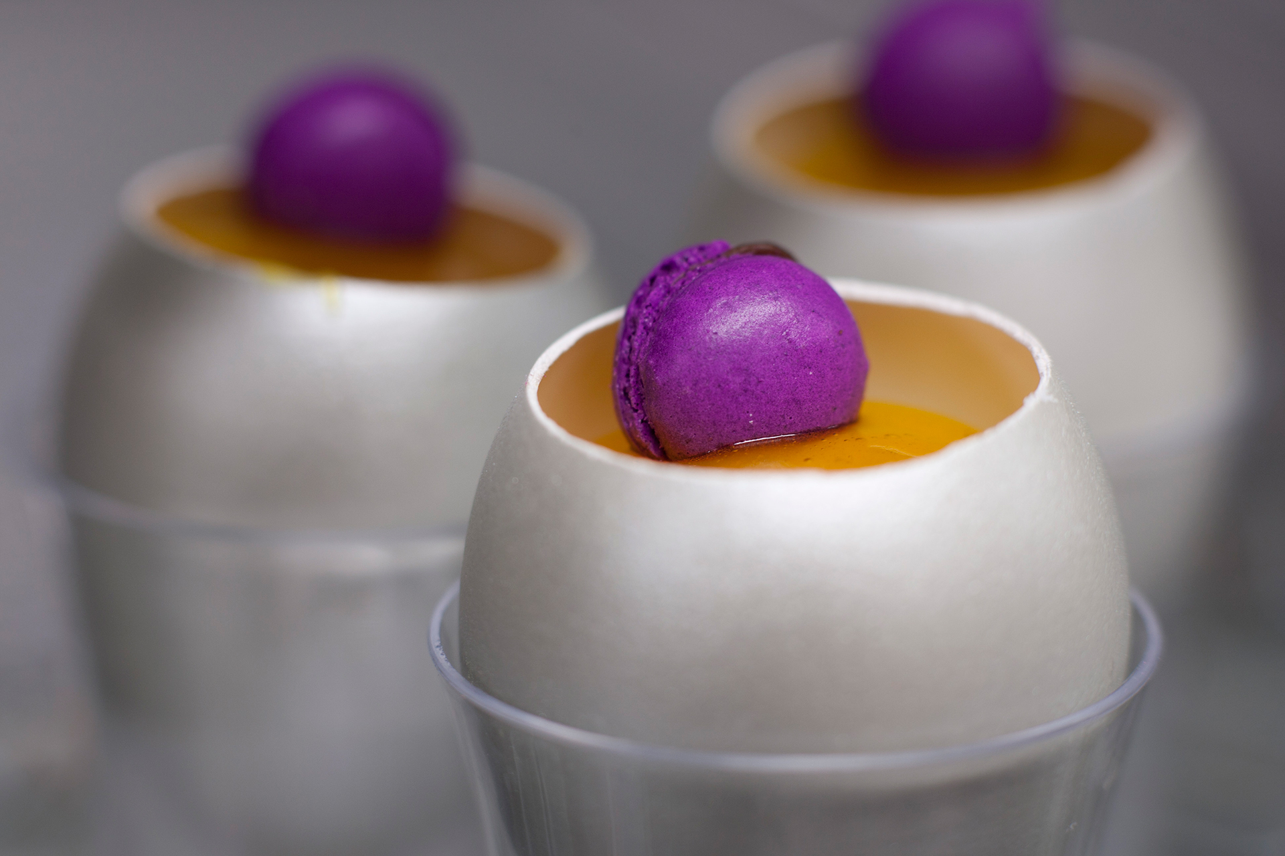
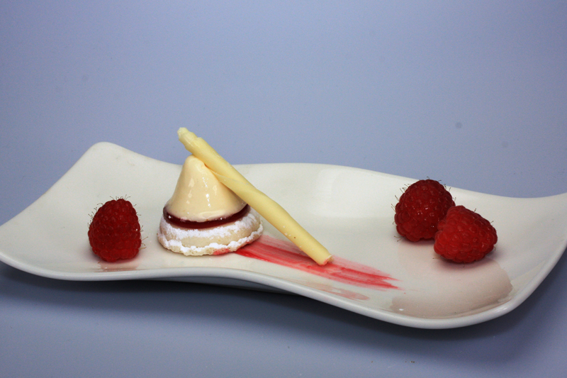
Macarons
Versatile
Colorful
Fun
Not Sleazy…Just Easy
Enticing tempting desserts that leaves your clients
beckoning for more.
March 3, 2014
Presented by Donna Ford, CPCE
www.sweetmemoriesbakery.com
www.cravenc.com

Slide 12
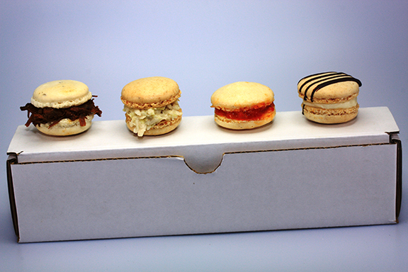
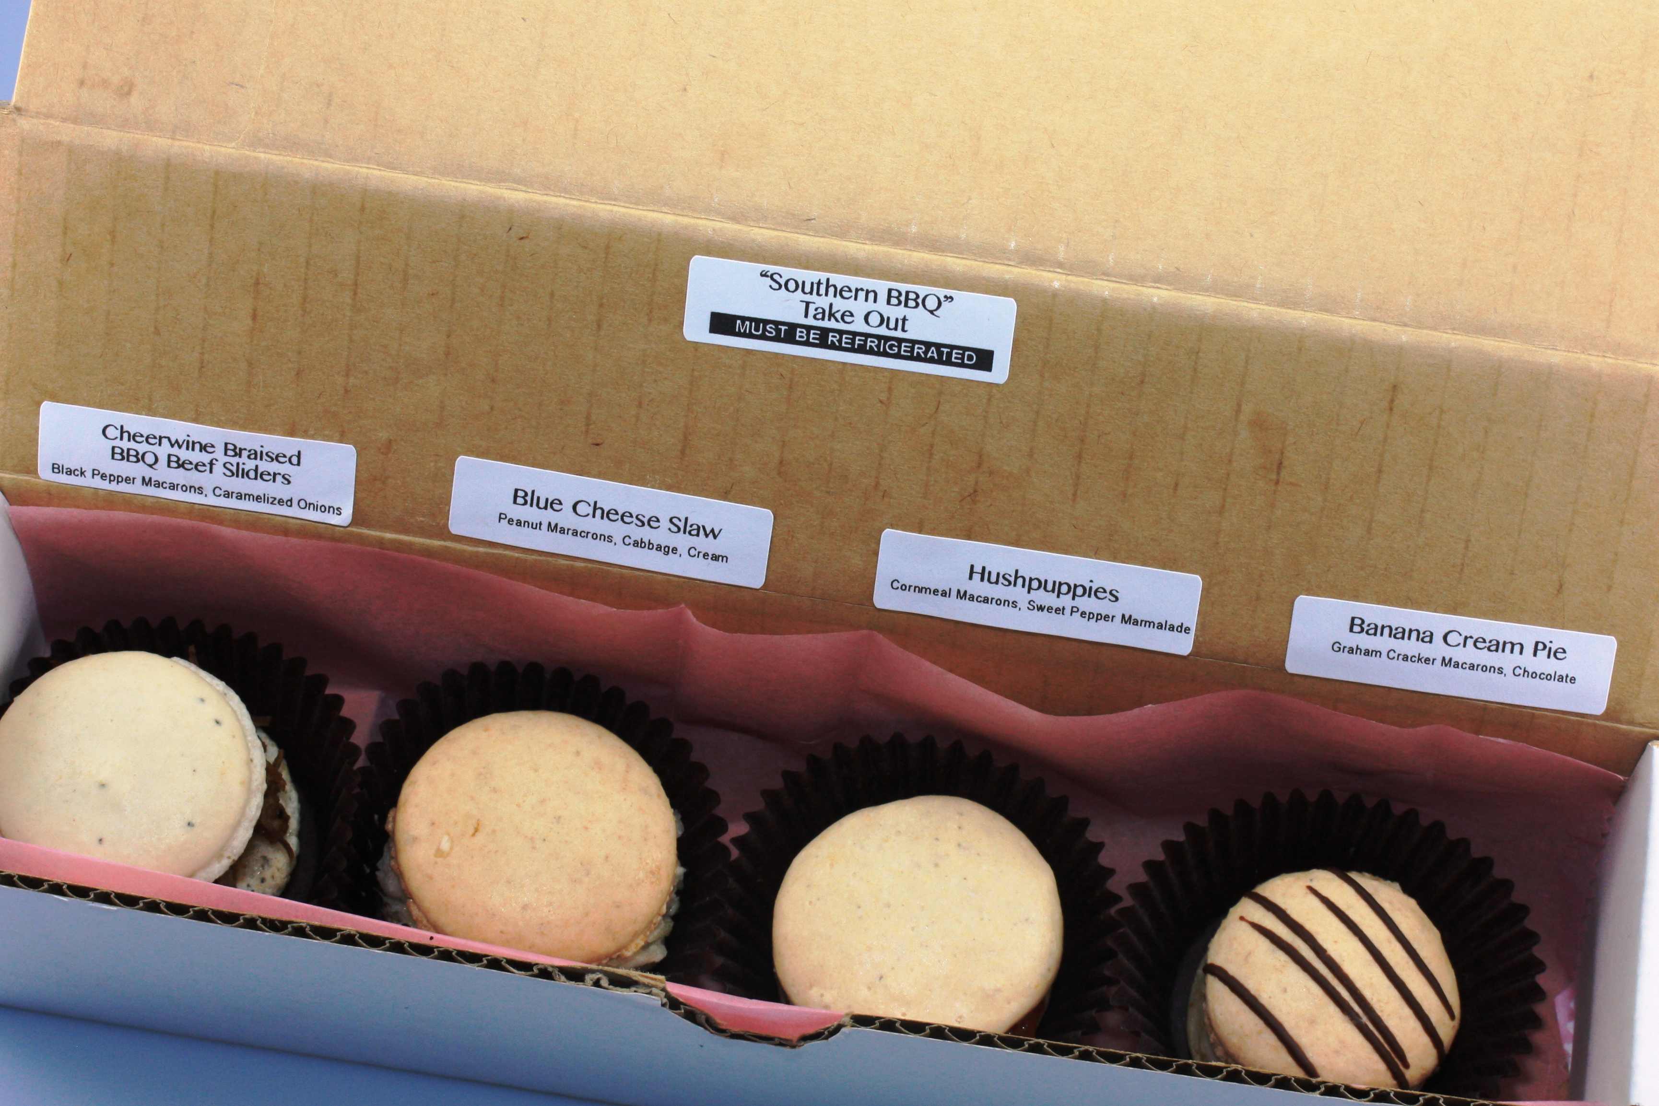
Macarons
Southern BBQ “Takeout”
Not Sleazy…Just Easy
Enticing tempting desserts that leaves your clients
beckoning for more.
March 3, 2014
Presented by Donna Ford, CPCE
www.sweetmemoriesbakery.com
www.cravenc.com

Slide 13
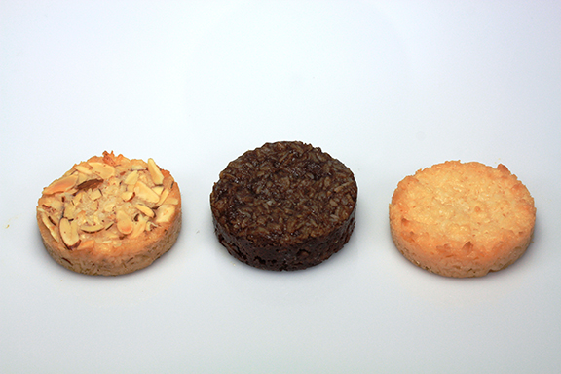
Macaroons
Not Sleazy…Just Easy
Enticing tempting desserts that leaves your clients beckoning for more.
March 3, 2014
Presented by Donna Ford, CPCE
www.sweetmemoriesbakery.com
www.cravenc.com

Slide 14
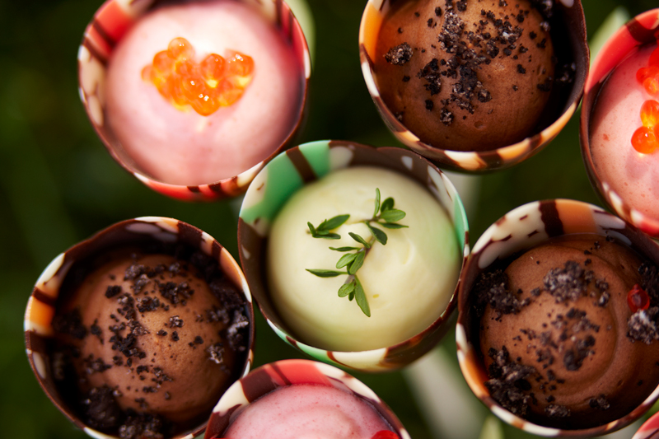
Unique Vessels
Not Sleazy…Just Easy
Enticing tempting desserts that leaves your clients beckoning for more.
March 3, 2014
Presented by Donna Ford, CPCE
www.sweetmemoriesbakery.com
www.cravenc.com

Slide 15
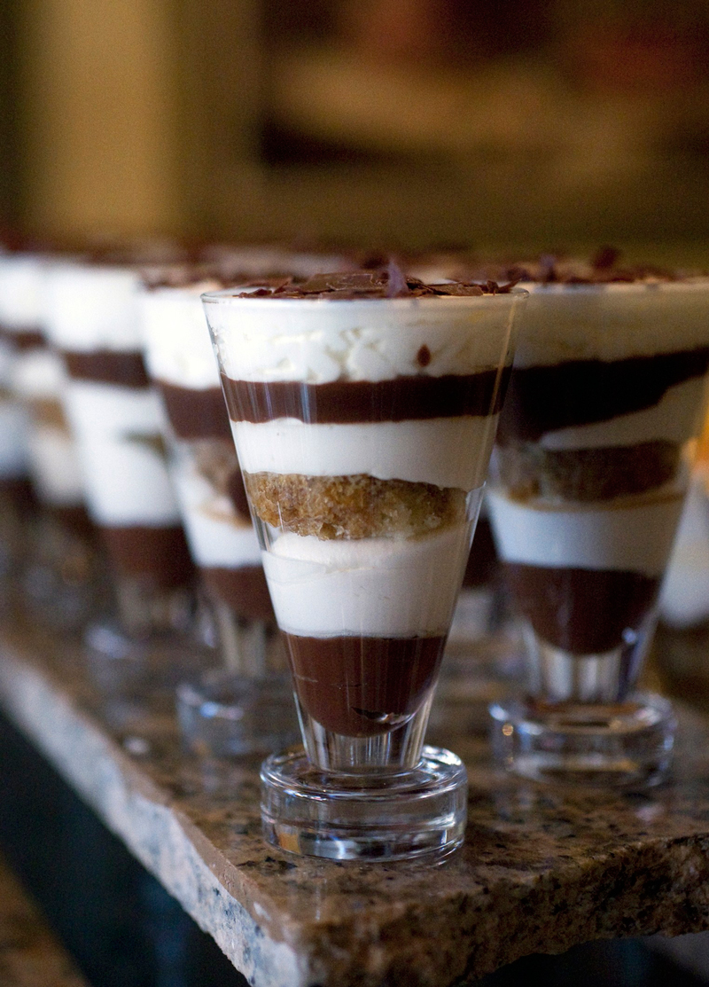
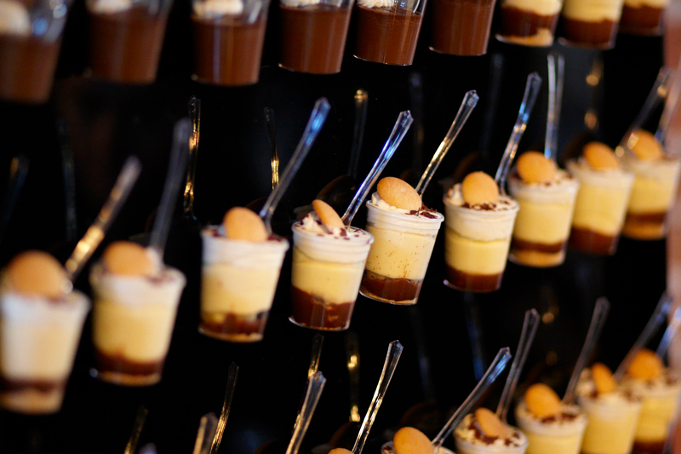
Unique Vessels
Not Sleazy…Just Easy
Enticing tempting desserts that leaves your clients beckoning for more.
March 3, 2014
Presented by Donna Ford, CPCE
www.sweetmemoriesbakery.com
www.cravenc.com

Slide 16
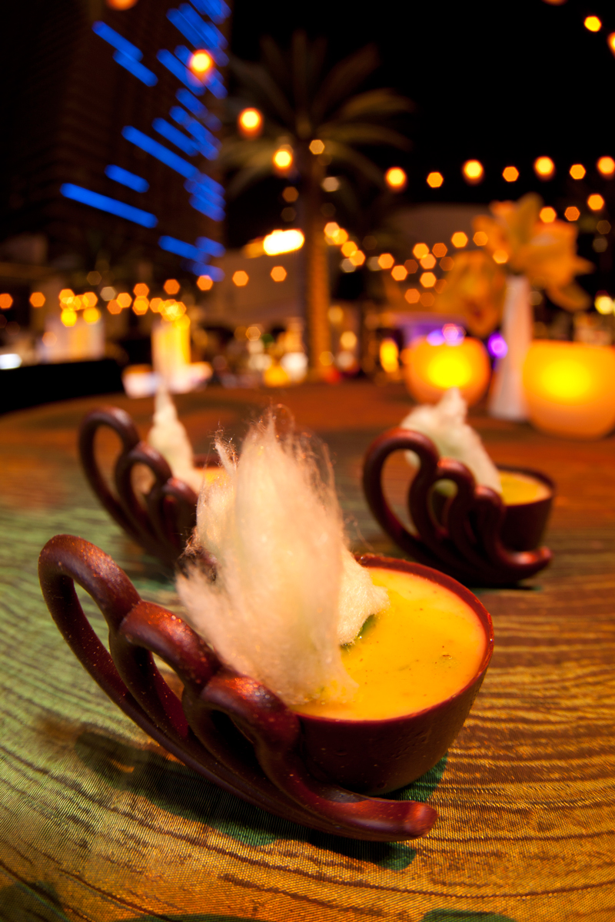
Unique Vessels
Not Sleazy…Just Easy
Enticing tempting desserts that leaves your clients beckoning for more.
March 3, 2014
Presented by Donna Ford, CPCE
www.sweetmemoriesbakery.com
www.cravenc.com

Slide 17
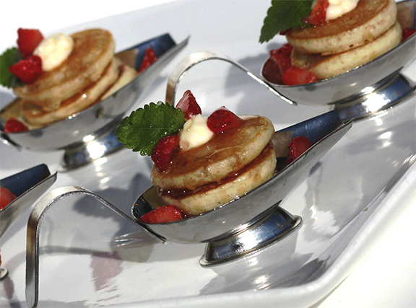
Breakfast
Anyone?
Not Sleazy…Just Easy
Enticing tempting desserts that leaves your clients
beckoning for more.
March 3, 2014
Presented by Donna Ford, CPCE
www.sweetmemoriesbakery.com
www.cravenc.com

Slide 18
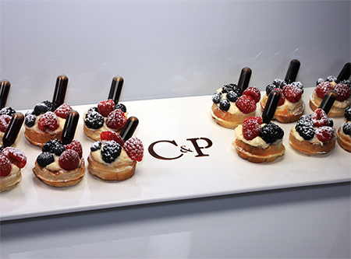
Breakfast
Anyone?
Not Sleazy…Just Easy
Enticing tempting desserts that leaves your clients beckoning for more.
March 3, 2014
Presented by Donna Ford, CPCE
www.sweetmemoriesbakery.com
www.cravenc.com

Slide 19
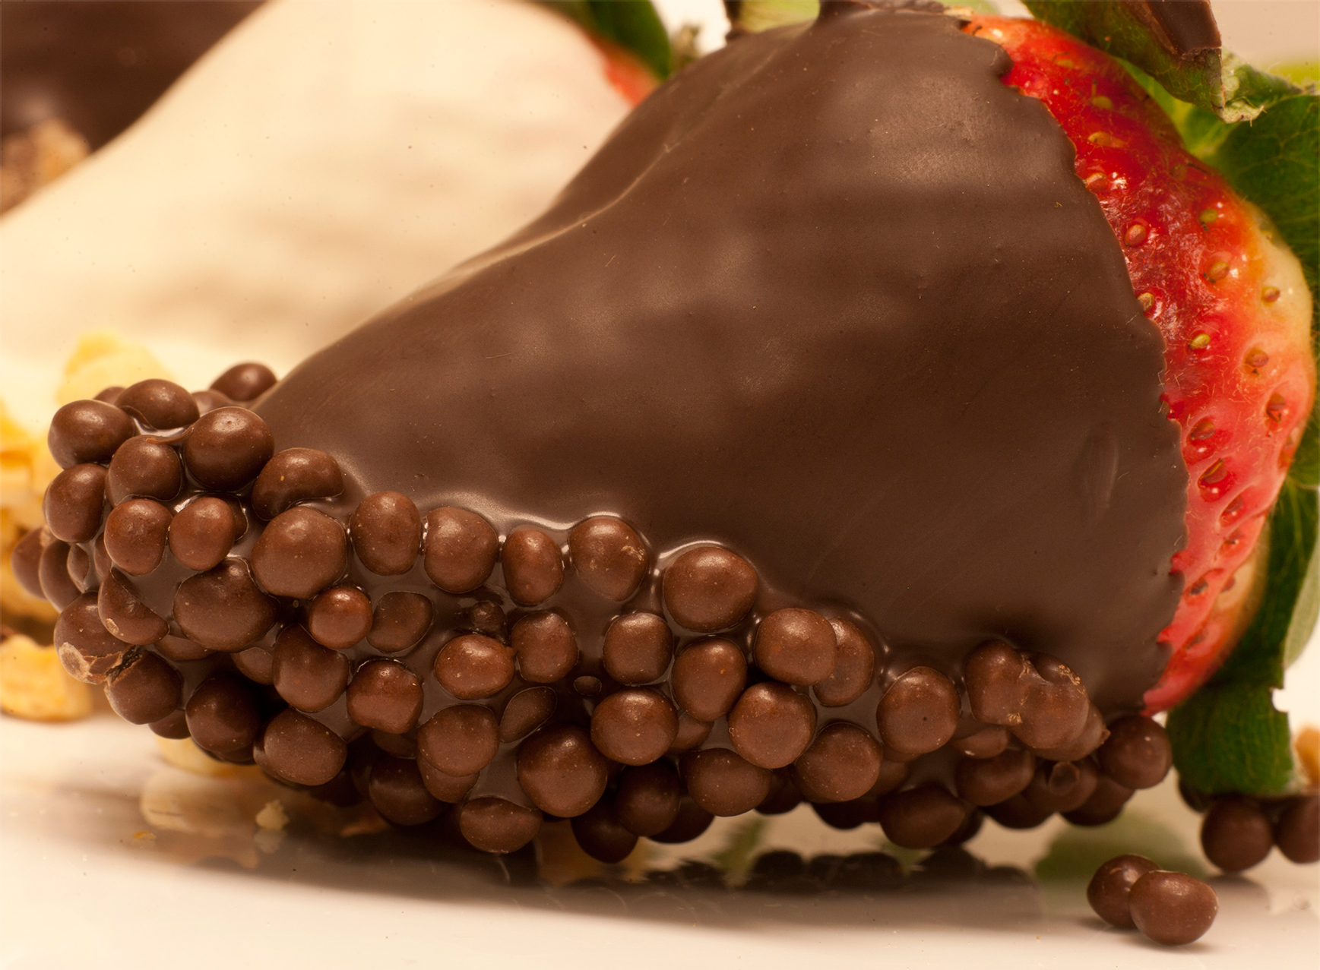
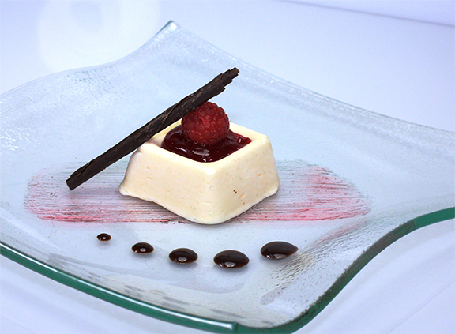
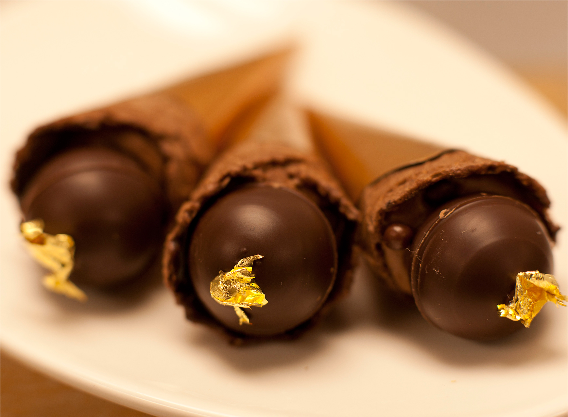
Other Finishes
Not Sleazy…Just Easy
Enticing tempting desserts that leaves your clients
beckoning for more.
March 3, 2014
Presented by Donna Ford, CPCE
www.sweetmemoriesbakery.com
www.cravenc.com

